Slide 1
2020.Sejong.RCVWS
-2.5D Pedestrian Detection-
bigchan@rcv.sejong.ac.kr
jiwon@rcv.sejong.ac.kr

Slide 2
3D Detection

Slide 3
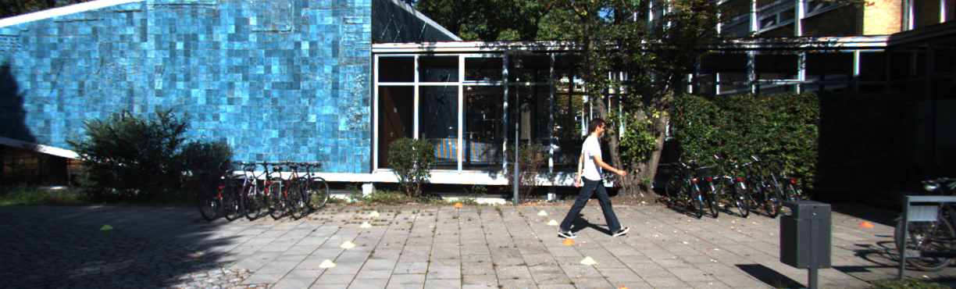
3D vs 2D Detection
-2D
[X,Y]=[712.40,143.00]
[X,Y]=[ 810.73,307.92]
2D Detection= object의 [x1,y1,x2,y2] 구함

Slide 4
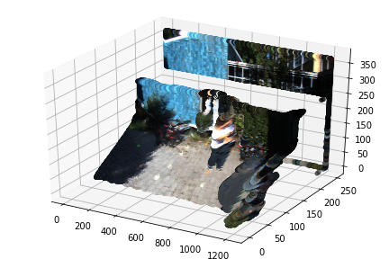
3D vs 2D Detection
-3D
Direction
Depth
3D 공간 상의 Box 위치 정보 획득

Slide 5
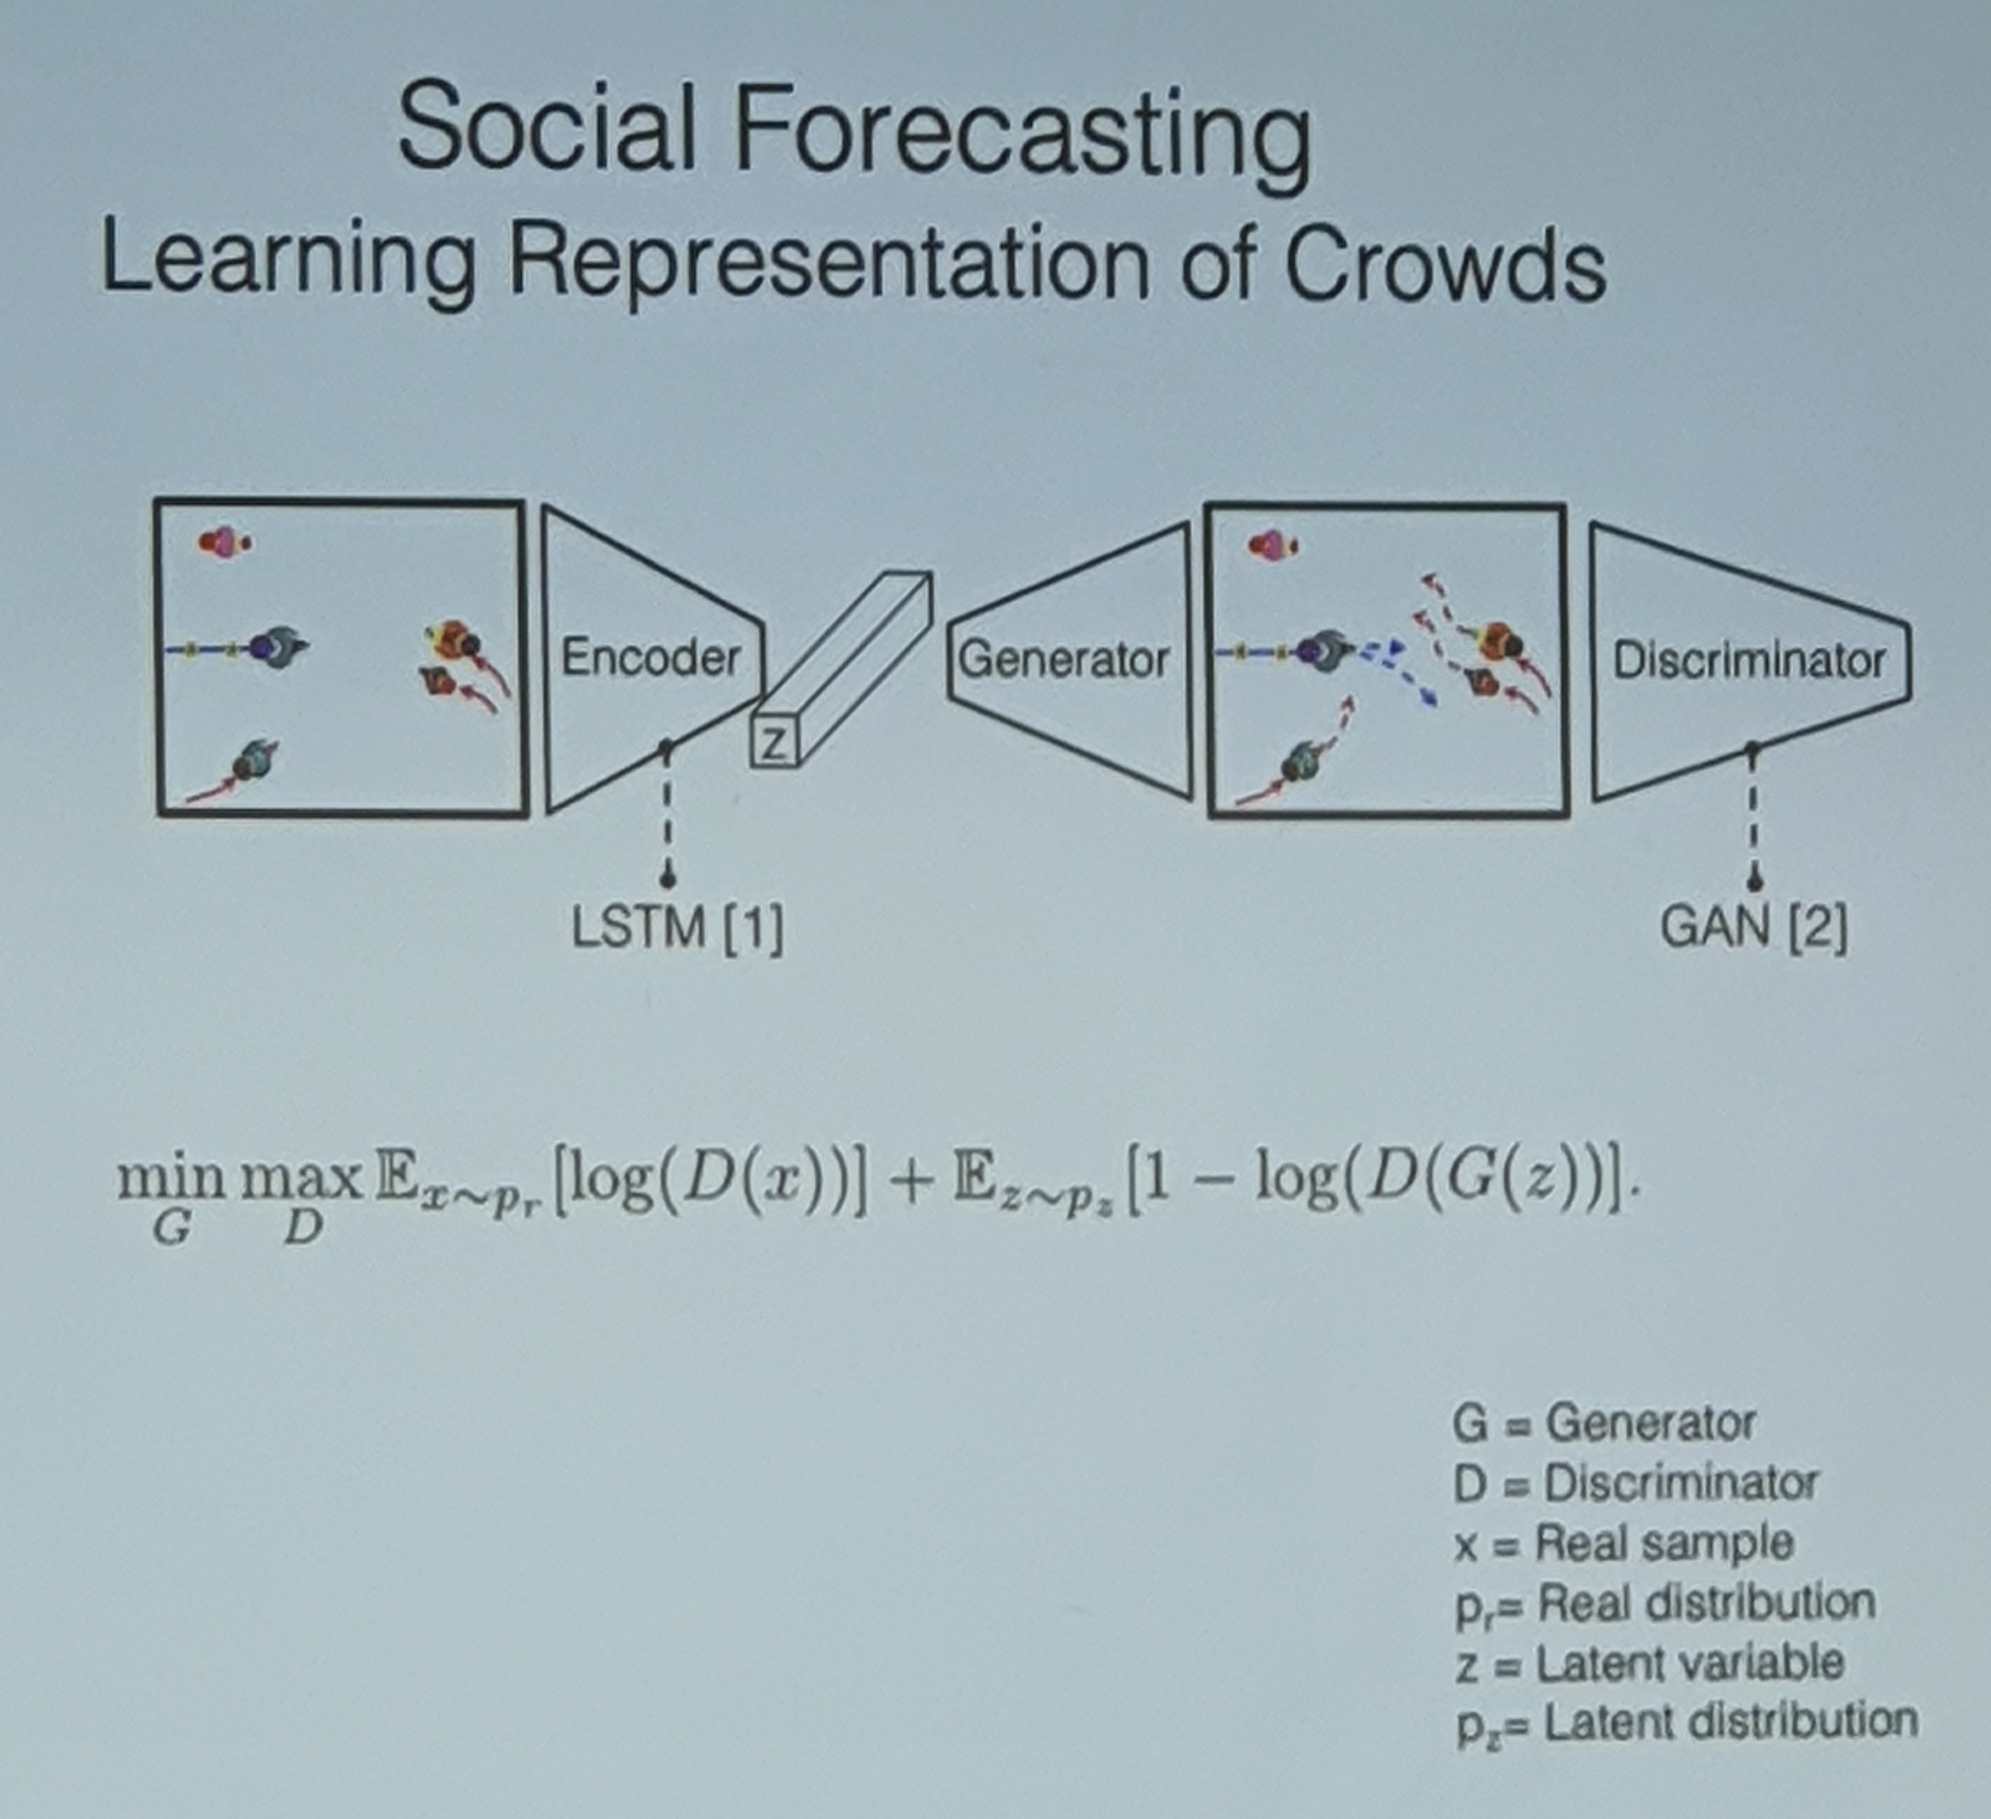
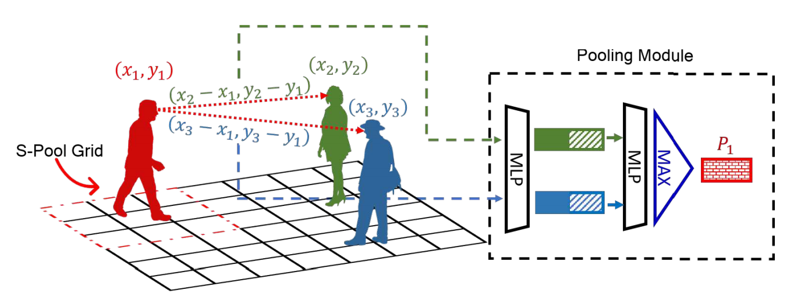
Direction
- 보행자의 예상 경로 예측
Gupta, Agrim, et al. "Social gan: Socially acceptable trajectories with generative adversarial networks." Proceedings of the IEEE Conference on Computer Vision and Pattern Recognition. 2018.

Slide 6
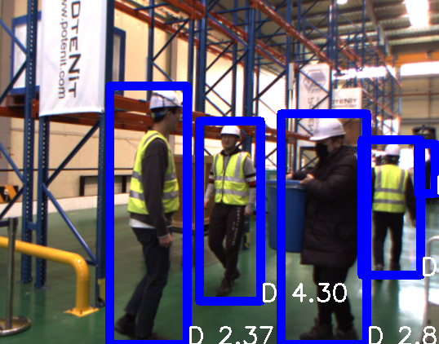
Depth
Ground Truth
Too Near 0~2m
Near 2~4m
Moderate 4~6m
Far 6~ m

Slide 7
M3D-RPN: Monocular 3D Region Proposal Network for Object Detection
Garrick Brazil, Xiaoming Liu Michigan State University, East Lansing MI
ICCV2019

Slide 8
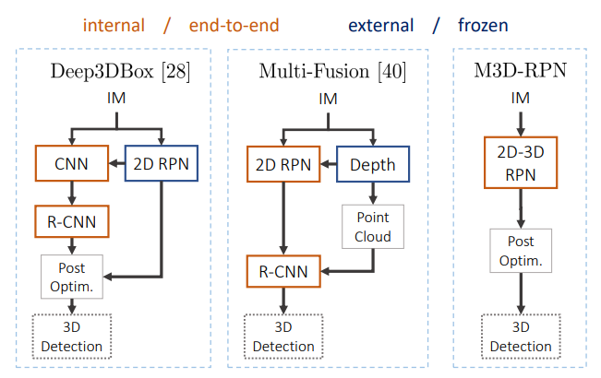
Single-Shot Network
인공지능 기

Slide 9
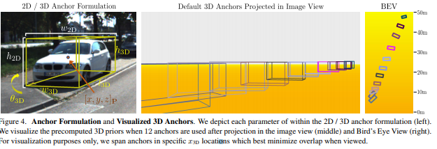

Slide 10
3D vs 2.5D
-2.5D
보행자의 Direction 불필요
보행자의 Depth 값만 필요
박스에 대표되는 Depth 값 하나만 있으면 됨
GT 제작에 용이

Slide 11
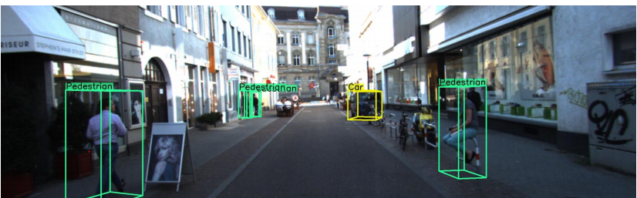
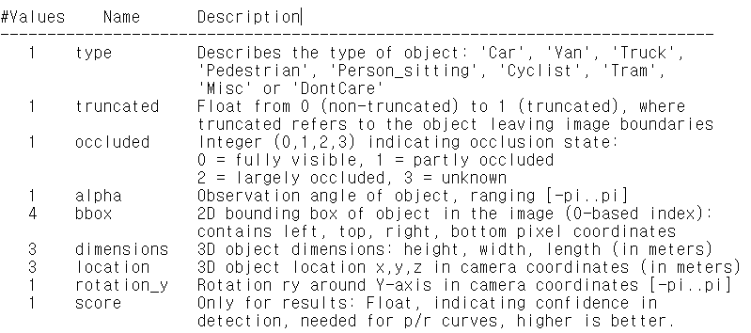
3D vs 2.5D
-3D
Pedestrian 0.00 0 -0.20 712.40 143.00 810.73 307.92 1.89 0.48 1.20 1.84 1.47 8.41 0.01직육면체의 정보가 다 필요.

Slide 12
2.5D Detection

Slide 13
2.5D Depth Regression
기존 2D Detection
X | Y | X | Y
Detection model
loc
cls

Slide 14
2.5D Depth Regression
2D Detection+ Depth Regression
X | Y | X | Y
Depth
Detection model
loc
cls
단순히 Depth 만 Regression 하면 성능이 나오지 않음

Slide 15
Multi classification
Ground Truth
Too Near 0~2m
Near 2~4m
Moderate 4~6m
Far 6~ m

Slide 16
2.5D Depth classification
X | Y | X | Y
Detection model
loc
cls
기존 2D Detection
Backgroud | Pedestrian

Slide 17
2.5D Depth classification
X | Y | X | Y
Detection model
loc
cls
Backgroud | Pedestrian2M | Pedestrian4M | … etc
Multi class
0 | 0 | 1 | … etc
Multi label
0 | 1 | 1 | … etc

Slide 18
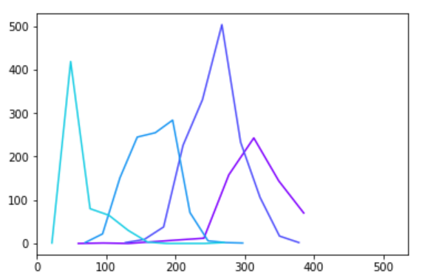
Depth Label Processing
Near
Far
Moderate
The number of height
Too Near
Height

Slide 19
Depth Label Processing
https://github.com/sejong-rcv/2020.RCVWS/blob/master/6%EC%9D%BC%EC%B0%A8_2.5D_Detection/Make_DepthLabel.ipynb
Label를 나누는 코드는 위에 올라 와 있습니다.

Slide 20
Depth Label Processing
기존 json(Label) 을 통해 Depth 값 받기
정해둔 Depth 범위에 따라 라벨링 새로 해서 Json을 저장
새로 저장한 Json에서 Depth 와 Height를 불러와 라벨에 따라 저장
각 라벨을 10개의 구간으로 나눠서 그 구간에 빈도수를 저장
저장된 빈도수와 그 빈도수의 heigh를 시각화

Slide 21
Depth Label Processing
Test
(Easy) Label을 변화 시켜 보면서 Height가 안 겹치도록 경향성을
실험해보기
(Hard) MultiLabel classification 을 위한 json 제작

Slide 22
System Architecture
2D Detect model 학습
Calibration
Parameter
이용해
영상 변환 및
뎁스 추출
Annotation
통해
Ground Truth
(Bounding Box)
추출
모델 학습
2.5D Detect model 학습
R2T2 시스템을 통한 데이터 수집
실시간으로
받은 영상 Rectify
와
스티칭 진행
Python -> C++로 변환된 모델에 forward
모델 실시간
Inference

Slide 23
Lunch time

Slide 24
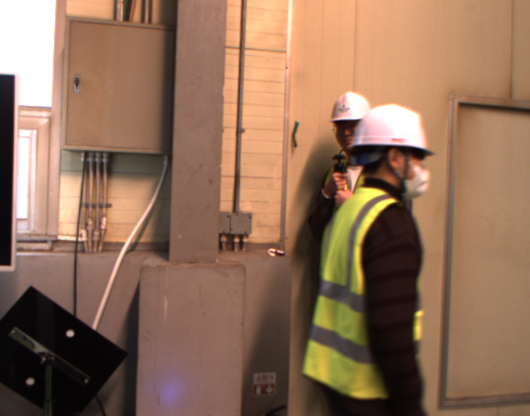


bbox 220 400 280 600
Label person
Occlusion 2
…
Json, xml, yaml …

Slide 25

VGG16
AuxiliaryConvolutions
PredictionConvolutions
localization
classification
Sejong Pedestrian Detection
MultiBox Loss

Slide 26
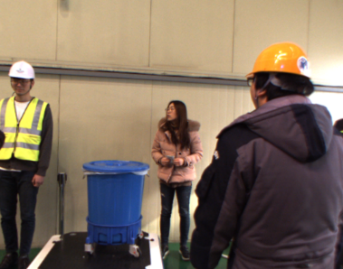
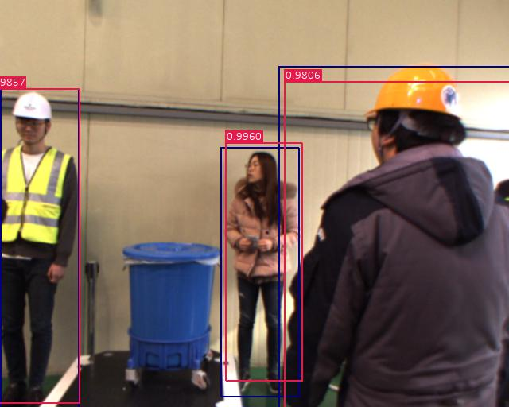
VGG16
AuxiliaryConvolutions
PredictionConvolutions
localization
NMS
classification
Sejong Pedestrian Detection

Slide 27
2.5D Object Detection (Multi Class)

Slide 28
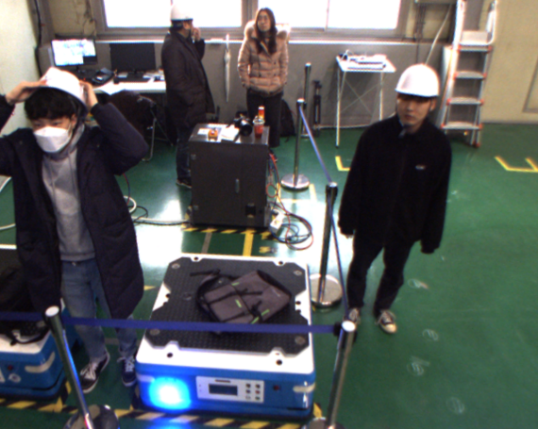
1~2m
2~3m
3~4m
4~5m
5m~
0 | 0 | 0 | 0 | 0

Slide 29
1~2m
2~3m
3~4m
4~5m
5m~
0 | 0 | 0 | 0 | 1
1 | 0 | 0 | 0 | 0
0 | 0 | 1 | 0 | 0

Slide 30
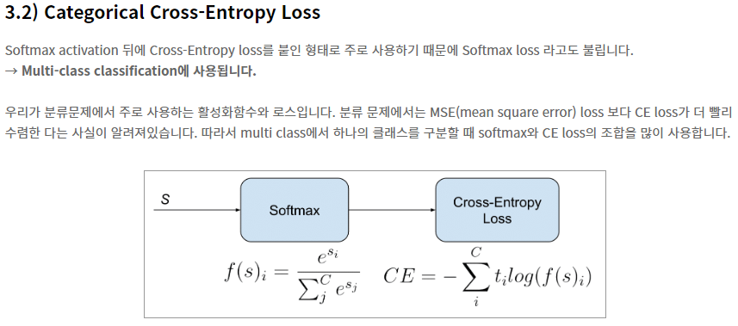
https://gombru.github.io/2018/05/23/cross_entropy_loss/
https://ratsgo.github.io/deep%20learning/2017/09/24/loss/

Slide 31
1~2m
2~3m
3~4m
4~5m
5m~
0 | 0 | 0 | 0.2 | 0.8
0.7 | 0.3 | 0 | 0 | 0
0 | 0.4 | 0.5 | 0.1 | 0

Slide 32
2.5D Object Detection (Multi Label)
https://wordbe.tistory.com/entry/ML-Cross-entropyCategorical-Binary%EC%9D%98-%EC%9D%B4%ED%95%B4

Slide 33
1~2m
2~3m
3~4m
4~5m
5m~
0 | 0 | 0 | 0 | 0

Slide 34
1~2m
2~3m
3~4m
4~5m
5m~
0 | 0 | 0 | 0 | 1
1 | 0 | 0 | 0 | 0
0 | 0 | 1 | 0 | 0

Slide 35
3.01
?
1~2m
2~3m
3~4m
4~5m
5m~
0 | 0 | 0 | 0 | 1
1 | 0 | 0 | 0 | 0
0 | 0 | 1 | 0 | 0

Slide 36
3.01
?
1~2m
2~3m
3~4m
4~5m
5m~
0 | 0 | 0 | 0 | 1
1 | 0 | 0 | 0 | 0
0 | 1 | 1 | 0 | 0

Slide 37
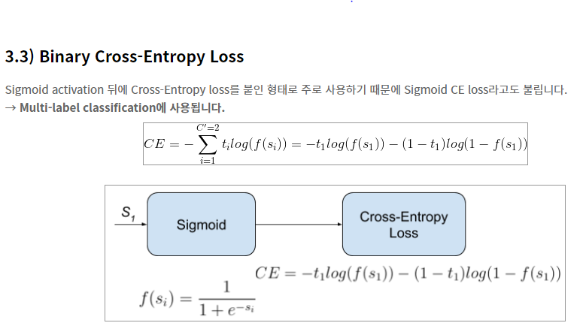
https://gombru.github.io/2018/05/23/cross_entropy_loss/
https://ratsgo.github.io/deep%20learning/2017/09/24/loss/

Slide 38
1~2m
2~3m
3~4m
4~5m
5m~
0 | 0 | 0 | 0.2 | 0.8
0.7 | 0.3 | 0 | 0 | 0
0 | 0.4 | 0.5 | 0.1 | 0
1~2m
2~3m
3~4m
4~5m
5m~
-0.5 | 0.01 | 0.01 | 0.01 | 0.99
0.89 | 0.01 | -0.5 | 0.01 | 0.01
0.01 | 0.89 | 0.97 | 0.01 | -0.5

Slide 39
2.5D Object Detection (Depth Regression)

Slide 40
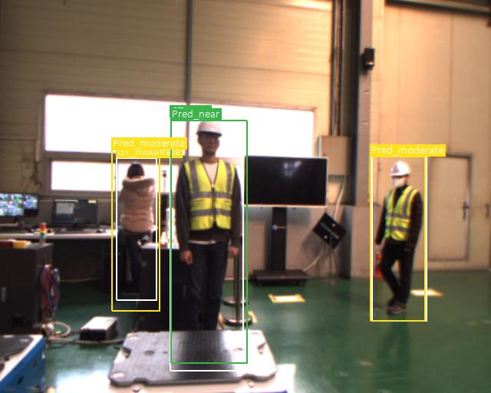
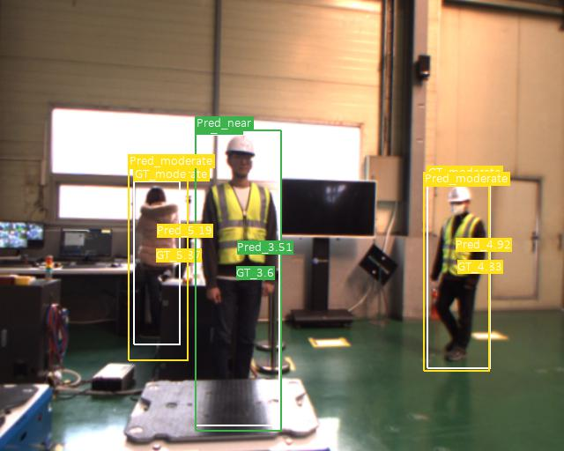
3.01

Slide 41
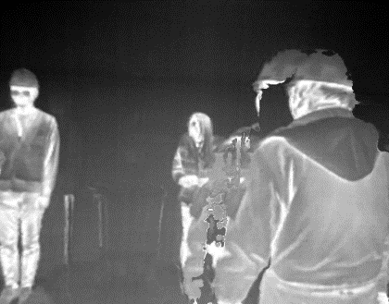


VGG16
AuxiliaryConvolutions
PredictionConvolutions
localization
classification
depth
Sejong Pedestrian Detection
MultiBox Loss

Slide 42
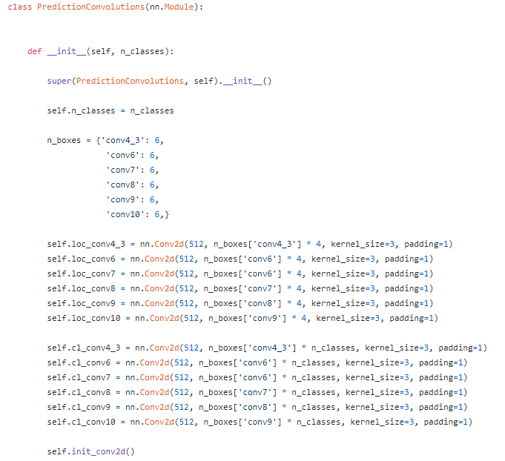
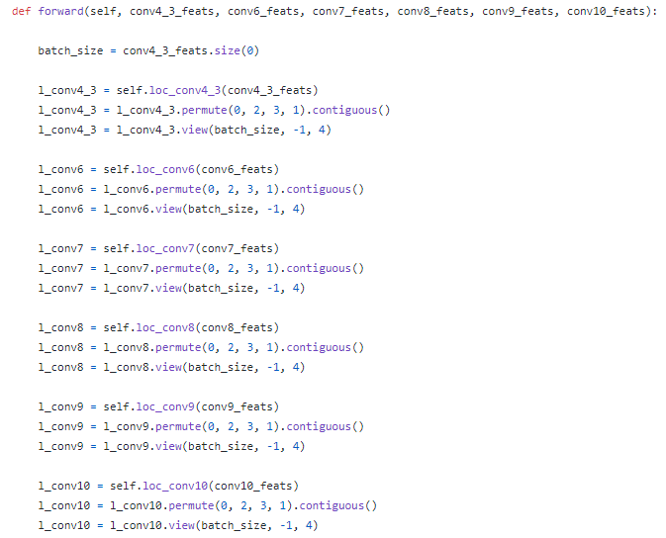
Prediction Convolutions

Slide 43
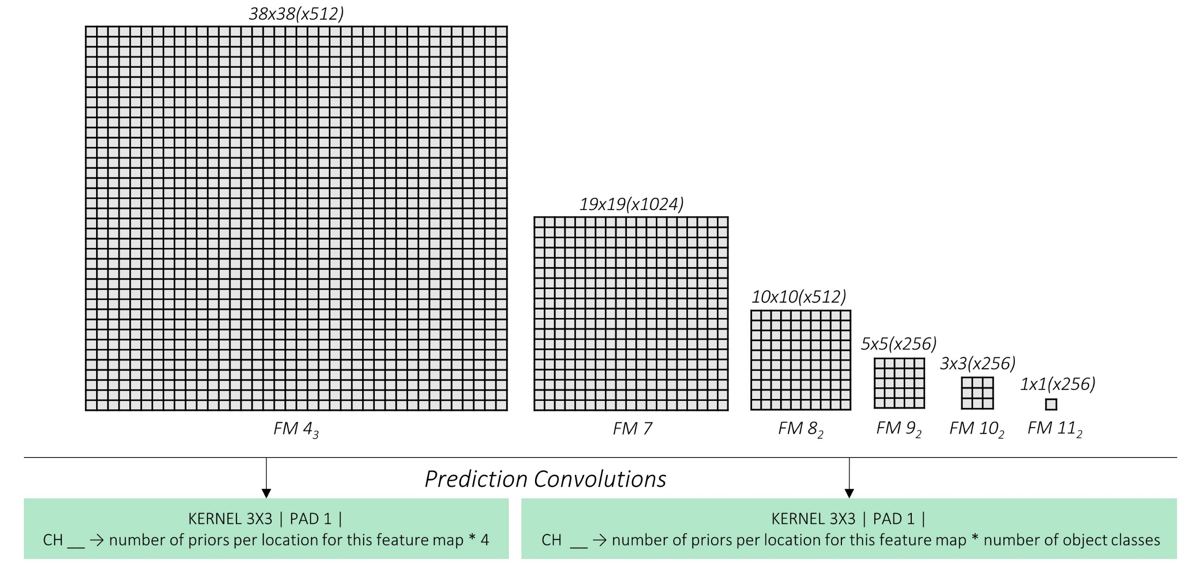
Prediction Convolutions

Slide 44
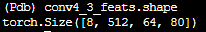
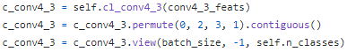
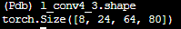
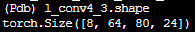
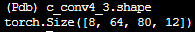
Prediction Convolutions

Slide 45


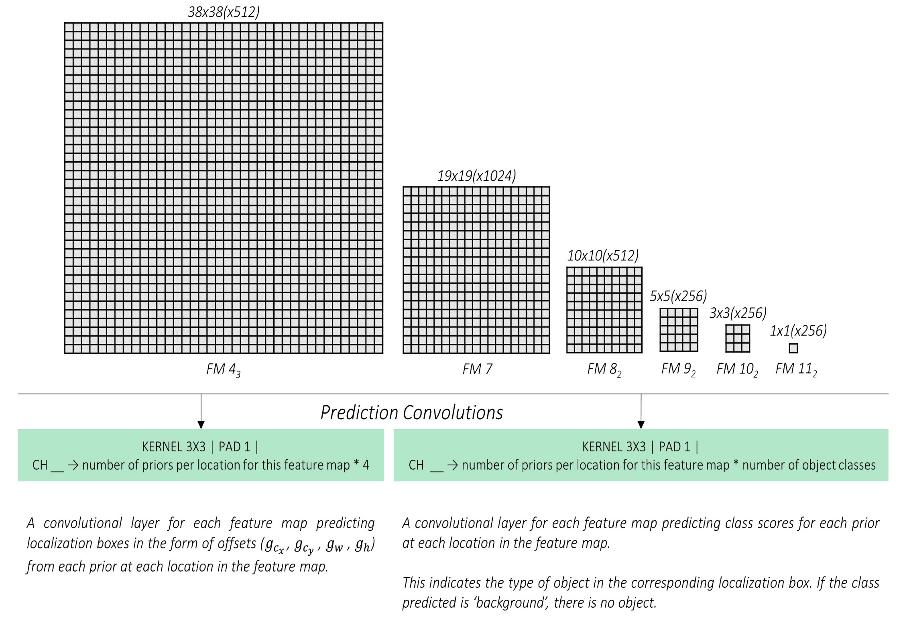

Prediction Convolutions
Number of priors per location for this feature map * 1

Slide 46
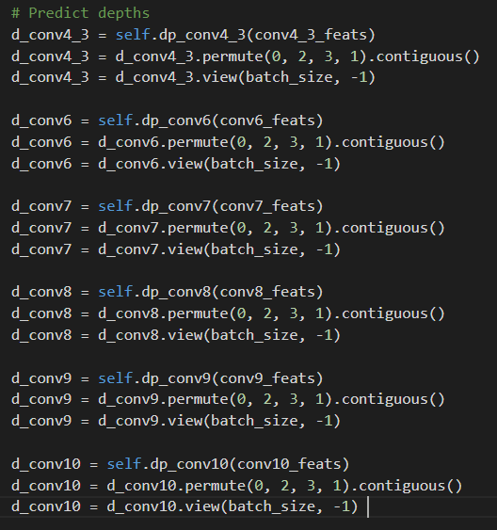
Prediction Convolutions

Slide 47
VGG16
AuxiliaryConvolutions
PredictionConvolutions
localization
classification
depth
Sejong Pedestrian Detection
MultiBox Loss

Slide 48
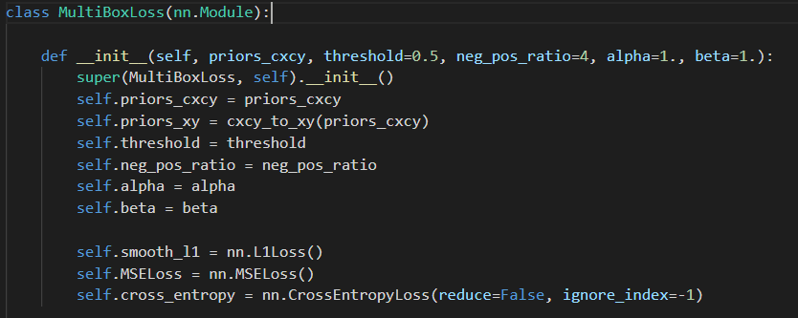
MultiBox Loss

Slide 49
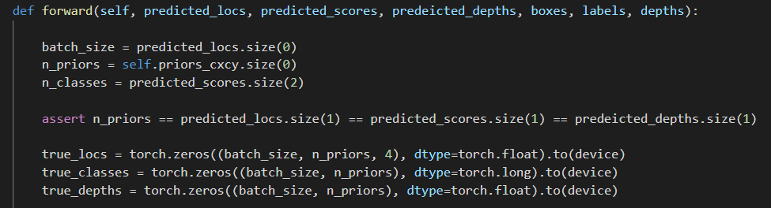
MultiBox Loss

Slide 50
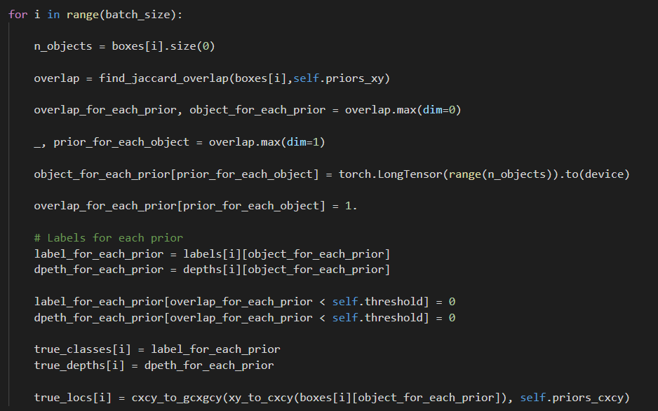
MultiBox Loss

Slide 51
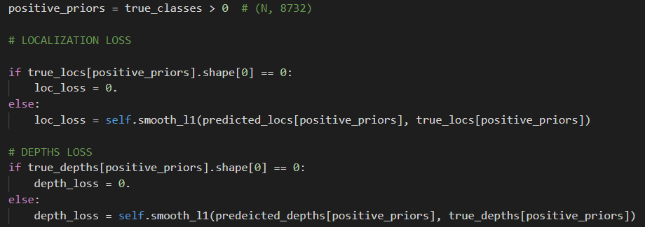
MultiBox Loss

Slide 52
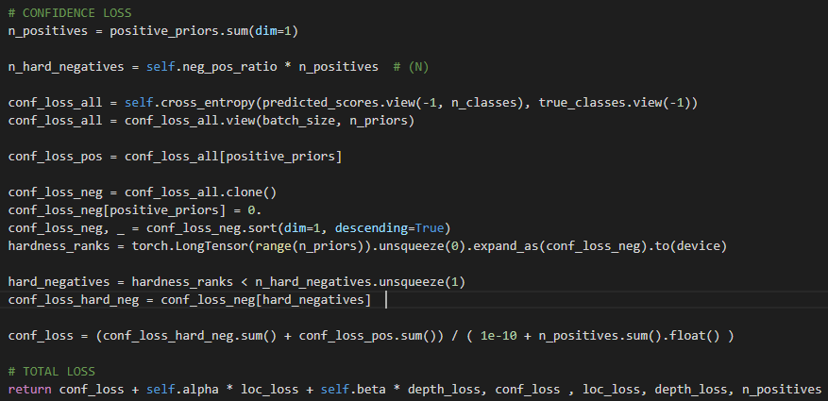
MultiBox Loss

